Slide 1
1.cpp 輸入一個數字
(1).確認此數字大於0
(2).印出是否是質數 (只檢查一個數字，就結束)
輸出必須完全一致才對!
請測試以下兩種輸出
Enter a positive number: -5
-5 is not a positive number!
Enter a positive number: 0
0 is not a positive number!
Enter a positive number: -100
-100 is not a positive number!
Enter a positive number: 9
9 is not a prime number.
Enter a positive number: -3
-3 is not a positive number!
Enter a positive number: 109
109 is a prime number.

Slide 2
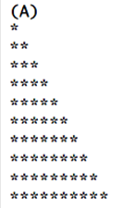

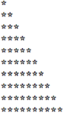
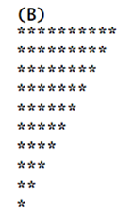
2.cpp (for)
Input an integer n, use nested for to print the two graphs as below (n: n number of levels of stars)
輸入正整數數 n(此題不檢查n)，以巢狀(多層)for迴圈，印出下列兩個圖案(n代表n層星星)
n=5
可以練習這個，不計分

